Slide 1
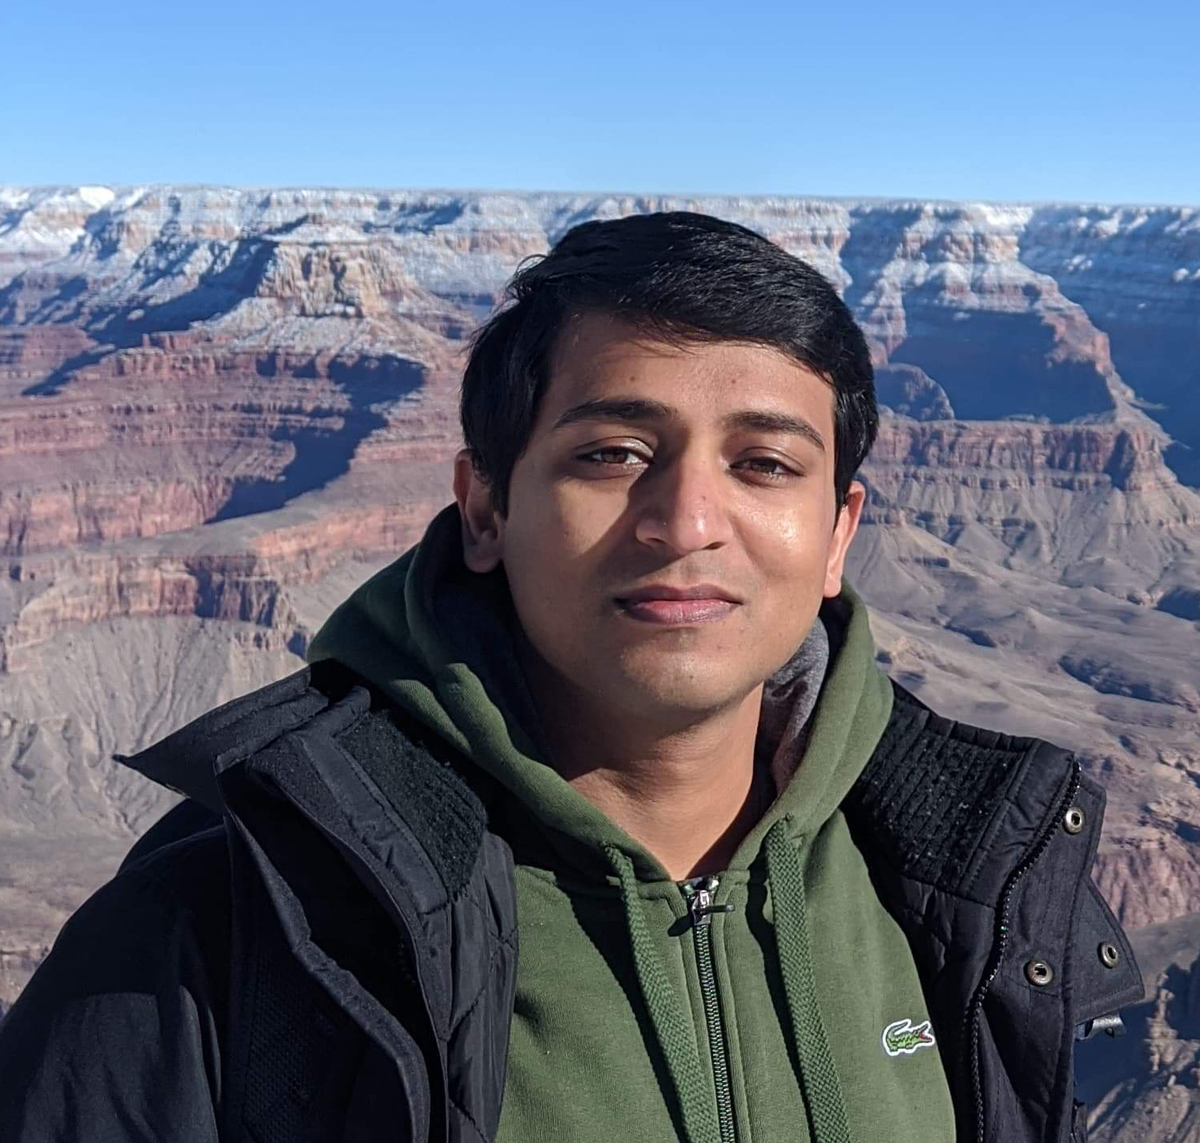
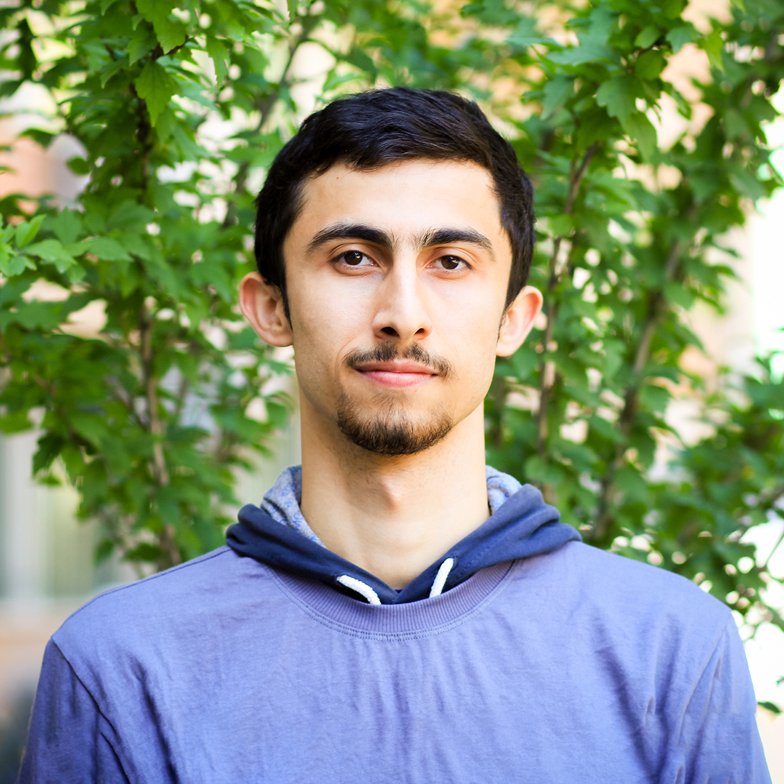
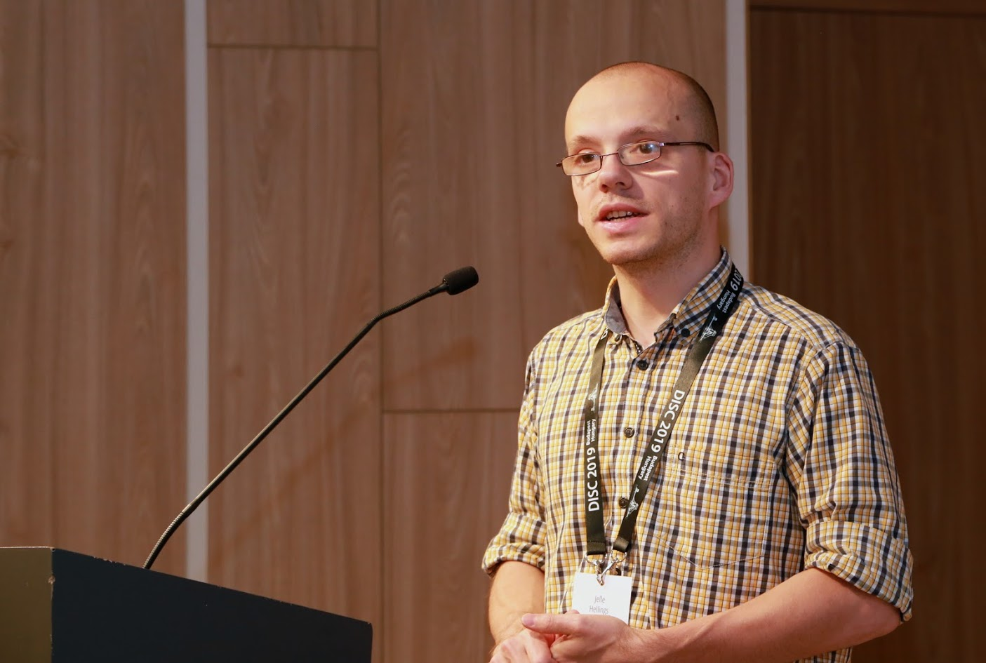

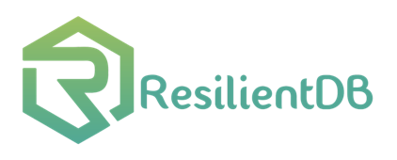
ResilientDB: Global Scale Resilient Blockchain Fabric
Suyash Gupta
Sajjad Rahnama
Jelle Hellings
Mohammad Sadoghi
Exploratory Systems Lab
University of California Davis

Slide 2
What is Blockchain?
New
Block
Previous
Hash
Genesis
Previous
Hash
Previous
Hash
Data
Data
Data
Client Transactions
Linked List of Blocks
Hash of Previous Block

Slide 3




Why Blockchain?
Democracy
Decentralization
Authentication
Security
By User:Pedant, User:Wapcaplet, User:Antonu, User:Vanderlindenma, User:.js. - Composition of File:Barnstar of Diligence Hires.png + File:Voting hand.svg., CC BY-SA 3.0, https://commons.wikimedia.org/w/index.php?curid=45960536

Slide 4












Blockchain Applications
Cryptocurrencies
Project Tracking
Waste
Management
Energy Trading
and Management
Healthcare

Slide 5

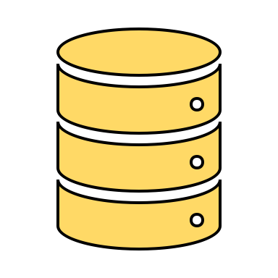
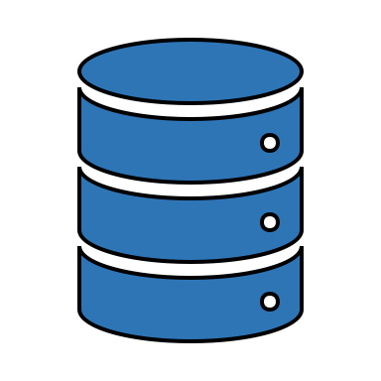

At the core of any Blockchain application is a Byzantine Fault-Tolerant (BFT) consensus protocol.
OK
OK
Order Txn
OK

Slide 6
First practical BFT implementation.
Practical Byzantine Fault Tolerance (PBFT)
Client
T
Primary
Replica 1
Replica 2
Byzantine
Replica
Client
Request
Pre-Prepare
O(n)
Prepare
O(n²)
Commit
O(n²)
Reply
Execute
Consensus among n replicas & at most f byzantine → n >= 3f+1
n = 4 replicas and f <= 1

Slide 7
Requirements of Existing BFT Protocols
Require three phases of communication, of which two necessitate quadratic communication (PBFT).
Expect no failures or dependence on clients (Zyzzyva).
Incur high client latencies due to many phases of communication (PBFT, HotStuff).
Require threshold signatures, which are computationally expensive (HotStuff).
Require more than 3f+1 replicas (Q/U, HQ).
Need trusted components (AHL, Attested Append-only memory).

Slide 8
Journey…
Efficient Commitment in Partitioned (Sharded) Databases.
EasyCommit [EDBT’18] → Two-Phase Non-Blocking Commit Protocol.
GeoScale EasyCommit [Distributed and Parallel Databases (DAPD) 2020]
Efficient Concurrency Control in Partitioned Databases.
QStore [EDBT’20] → Queued approach for distributed concurrency control.

Slide 9
Journey…
Efficient Two-Phase Byzantine-Fault Tolerant (BFT) Consensus Protocol
Proof-of-Execution [arxiv]
No twin-paths, no dependence on clients, no trusted component
Can employ both asymmetric and symmetric cryptographic signatures.
Efficient Resilient Concurrent Consensus Protocol
RCC [ICDE’21] → Run multiple parallel consensuses.
Throughput of order 300Ktxns/s among replicas.

Slide 10
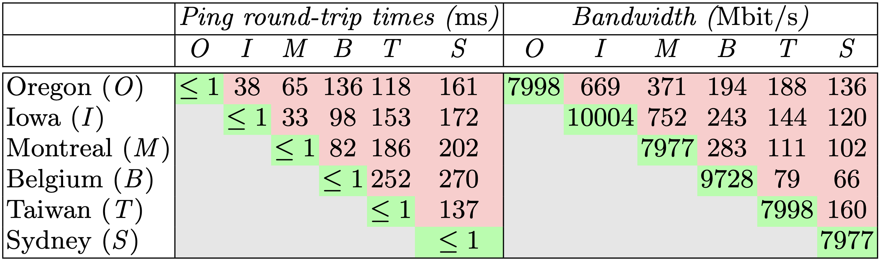

Challenges For Geo-Scale Blockchains
High!
Low!
Blockchain expects decentralization → Replicas maybe geo-distributed

Slide 11
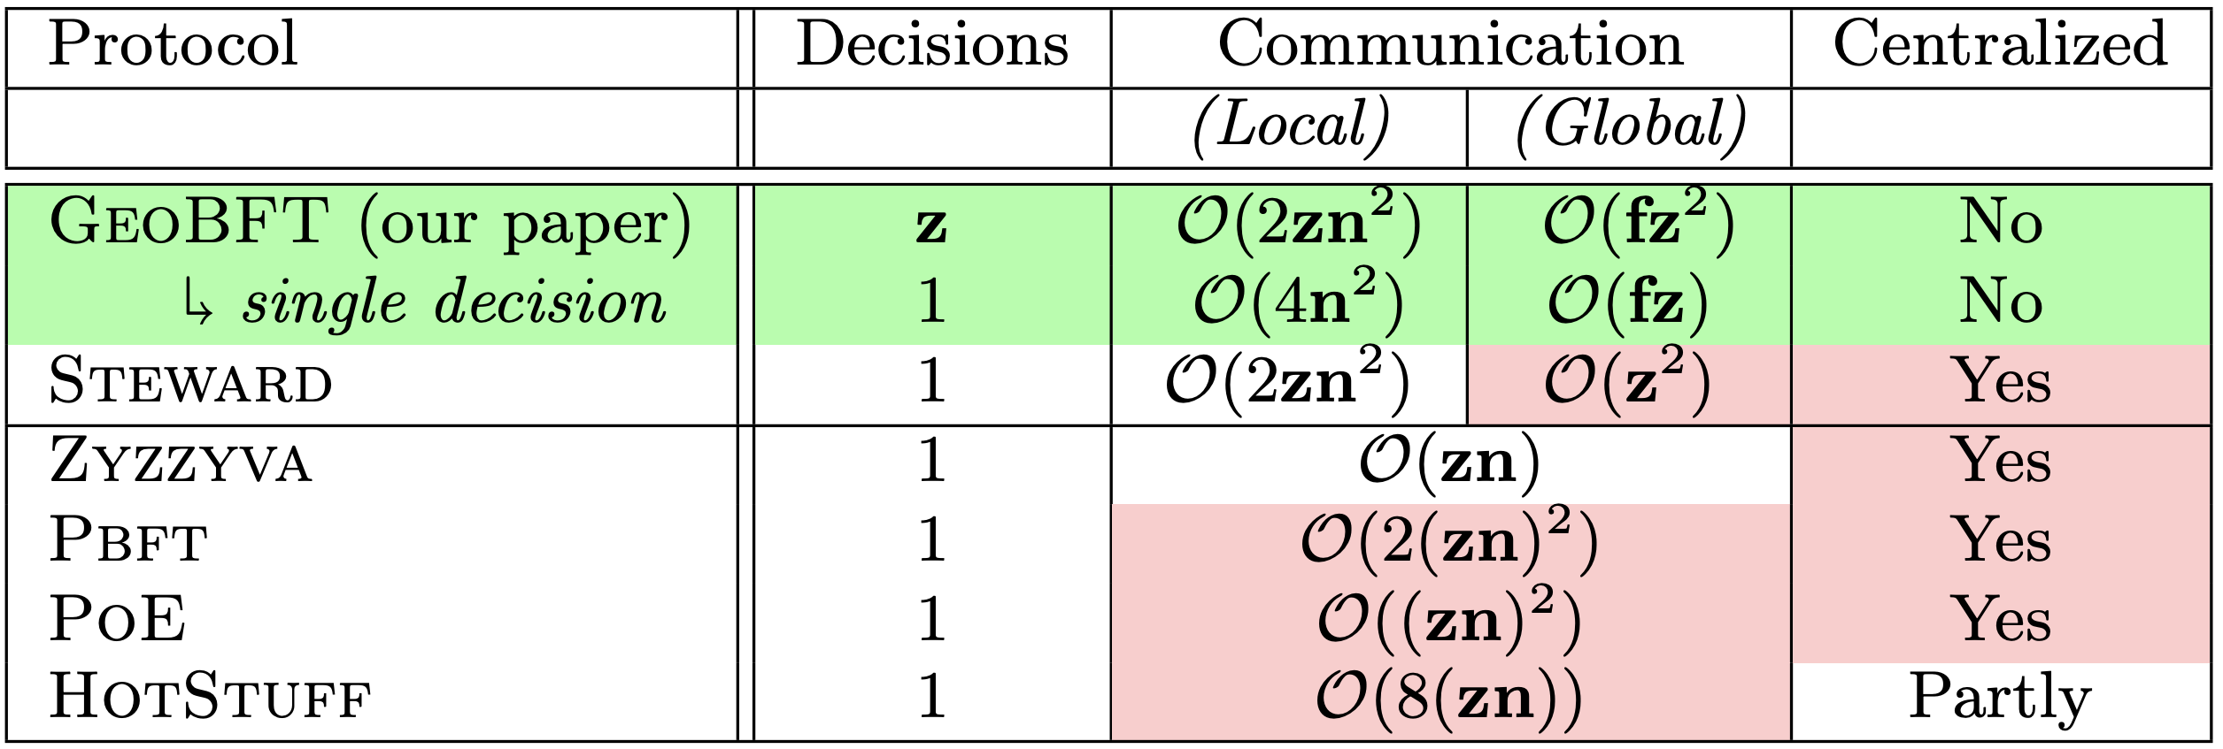
Limitations of Existing Consensus Protocols
Normal-case metrics for a system with z clusters, each with n replicas of which at most f , n > 3f , are Byzantine

Slide 12
GeoBFT Protocol
Local Replication
Inter-cluster Sharing
Ordering and Execution
Each cluster runs PBFT to select, locally replicate, and certify a client request.
Primary at each cluster shares the certified client request with other clusters.
Order the certified requests, execute them, and inform local clients.
Topology-aware protocol.
Parallel consensus at each cluster.
Low inter-cluster communication overheads.

Slide 13
Client
T₁
P_{C1}
Local PBFT Consensus on T₁
R_{1,1}
Cluster 1
C₁
R_{1,2}
R_{1,3}
Client
T₂
P_{C2}
Local PBFT Consensus on T₂
Cluster 2
C₂
R_{2,1}
R_{2,2}
R_{2,3}
Local Request
Local Replication
Global
Sharing
Local
Sharing
Reply

Slide 14
Local Replication
GeoBFT employs PBFT for local replication.
Tolerates up to f failure out of 3f+1 replicas
Three phases of which two require quadratic communication complexity.
Safety is always guaranteed and Liveness is guaranteed in periods of partial synchrony.
View-Change protocol for replacing malicious primary

Slide 15
PBFT Civil Execution
Client
T
Primary
Construct certificates that include T and n-f Commit messages.
Replica 1
Replica 2
Byzantine
Replica
Client
Request
Pre-Prepare
Prepare
Commit

Slide 16
Inter-Cluster Sharing
P_{C1}
P_{C2}
R_{2,1}
R_{2,2}
R_{2,3}
Global Phase
Local Phase
The Primary P_{C1} sends a certificate that includes the client request and commit messages from n-f replicas of Cluster C₁ .

Slide 17
Ordering and Execution
GeoBFT orders requests deterministically.
For i < j, requests of Cluster C_{i} are executed before requests of cluster C_{j}.
For example: requests of C₁ are executed before C₂ .

Slide 18
ResilientDB: High Throughput Yielding, Scalable Permissioned Blockchain Fabric*
Visit at: https://resilientdb.com/
*Proceedings of the 40th IEEE ICDCS 2020.

Slide 19
Why Should You Chose ResilientDB?
Bitcoin and Ethereum offer low throughputs of 10 txns/s.
Existing Permissioned Blockchain Databases still have low throughputs (20K txns/s).
Prior works blame BFT consensus as expensive.
System Design is mostly overlooked.
ResilientDB adopts well-researched database and system practices.

Slide 20
Dissecting Existing Permissioned Blockchains
Single-threaded Monolithic Design
Successive Phases of Consensus
Integrated Ordering and Execution
Strict Ordering
Off-Chain Memory Management
Expensive Cryptographic Practices

Slide 21
Can a well-crafted system based on a classical BFT protocol outperform a modern protocol?

Slide 22
ResilientDB Architecture
SECURE
LAYER
EXECUTION LAYER
THREADS
SIGNING
TOOLKIT
QUEUES
NET WORK
HASHING
TOOLKIT
BFT CONSENSUS
STORAGE LAYER
METADATA
BLOCKCHAIN

Slide 23
Implementation on ResilientDB
Network
Network
REPLICA
Client
Requests
Batching
Prepare & Commit
messages
Input
Output
Message from
Clients and Replicas
Message to
Replicas or Clients
Worker
Execute
Certificates
from other clusters
Certify
ResilientDB associates a multi-threaded deep-pipelined architecture with each replica.

Slide 24
Ledger (Blockchain) Management
i^{th} block in the ledger contains the i^{th} executed request.
In each round of GeoBFT, each replica executes z requests, each belonging to a different cluster C_{i} , 1 <= i <= z.
Hence, in each round, each replica creates z blocks.
To ensure immutability, each block includes both client requests and exchanged certificates.

Slide 25
Evaluating GeoBFT on ResilientDB

Slide 26
Evaluation Metrics
Google cloud used for deploying replicas and clients.
Each replica used 8-core Intel Skylake CPUs and had access to 16 GB memory.
Total 160K clients deployed on eight 4-core machines.
Workload provided by Yahoo Cloud Serving Benchmark (YCSB).
Replicas deployed across six different regions: Oregon, Iowa, Montreal, Belgium, Taiwan and Sydney.
Primaries for centralized protocol placed at Oregon (highest bandwidth).

Slide 27
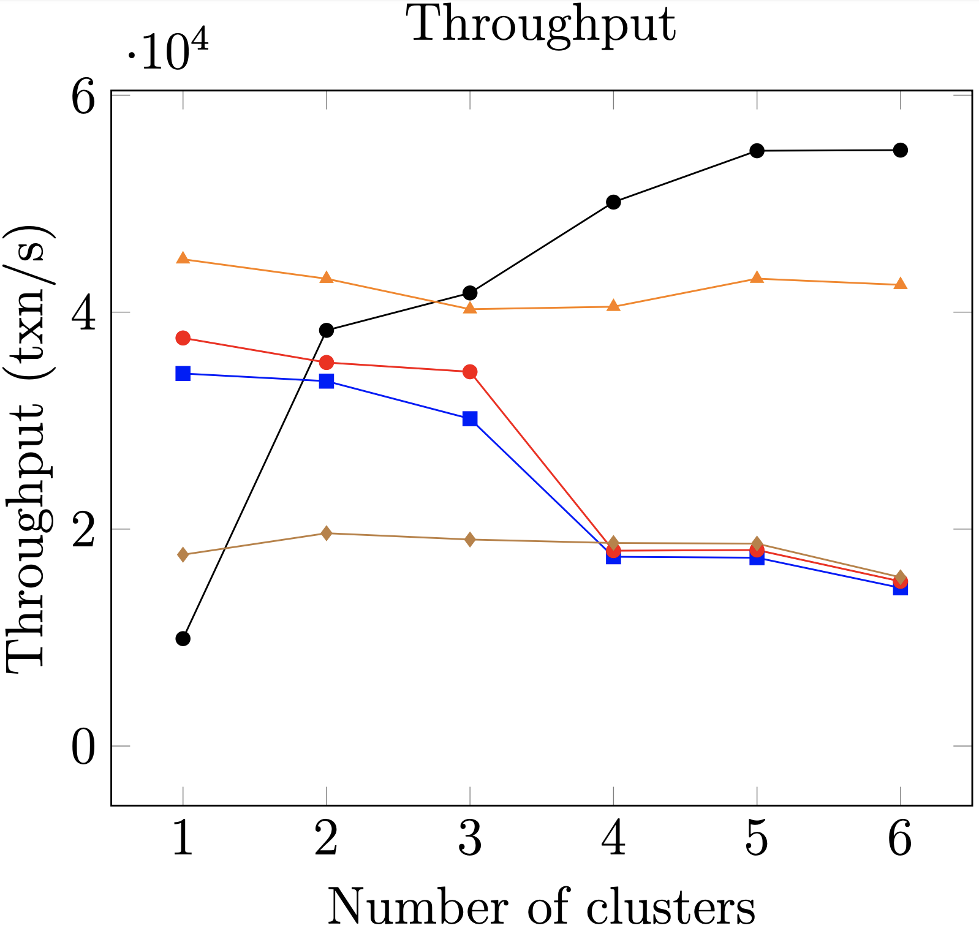
Scalability
1.3x
3.1x
Total replicas = 60

Slide 28
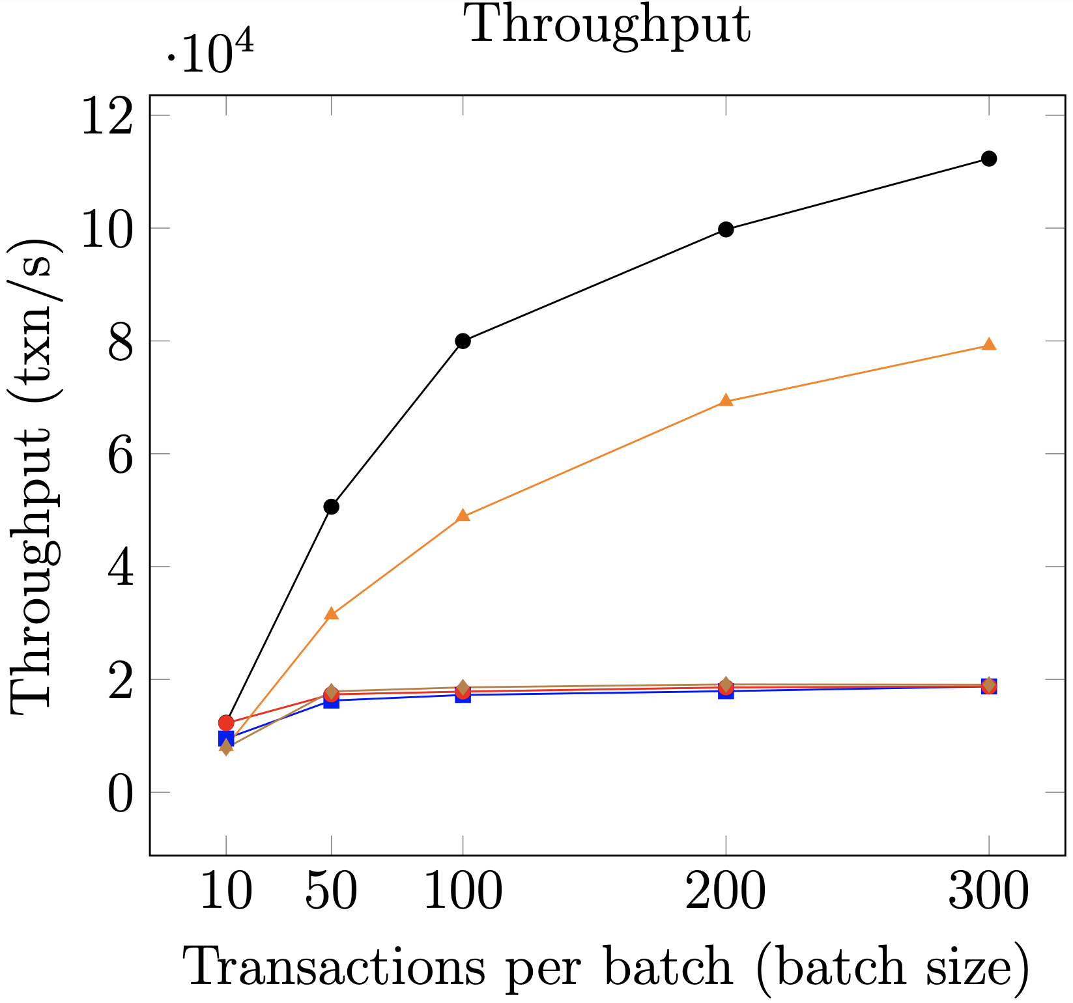
1.6x
6x
Batching
4 clusters and 7 replicas per cluster

Slide 29
Conclusions and Final Remarks
For achieving faster local replication, GeoBFT can employ other efficient BFT protocols, such as PoE.
Modern cryptographic techniques such as Threshold signatures can be used in place of sending n-f Commit messages.
If a cluster does not have a request, it can send “no-op” messages.
GeoBFT optimizes consensus by reducing global communication costs.
Parallel local replication helps to increase system throughput.

Slide 30
Thank You

